Slide 1
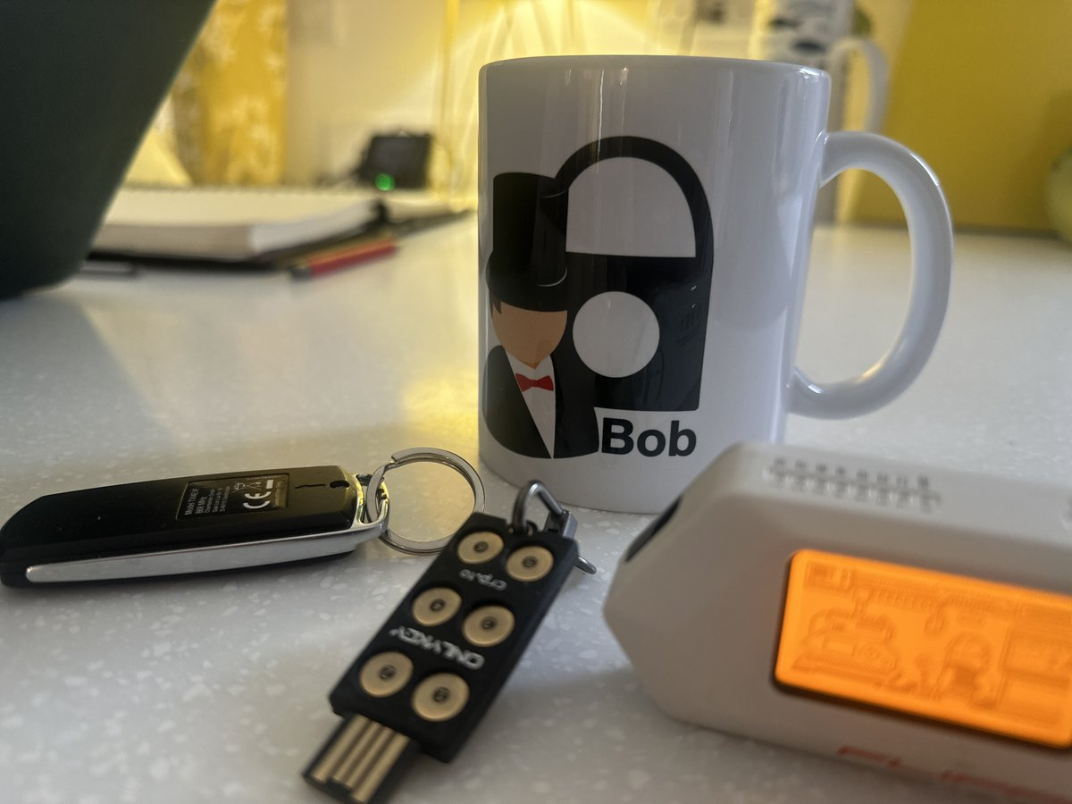
11. Host Security
TPM Chip.
Apple T2 Chip.
Disk Encryption: BitLocker.
Disk Encryption: TrueCrypt.
Entropy.
Prof Bill Buchanan OBE http://asecuritysite.com/esecurity

Slide 2
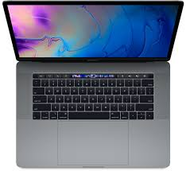
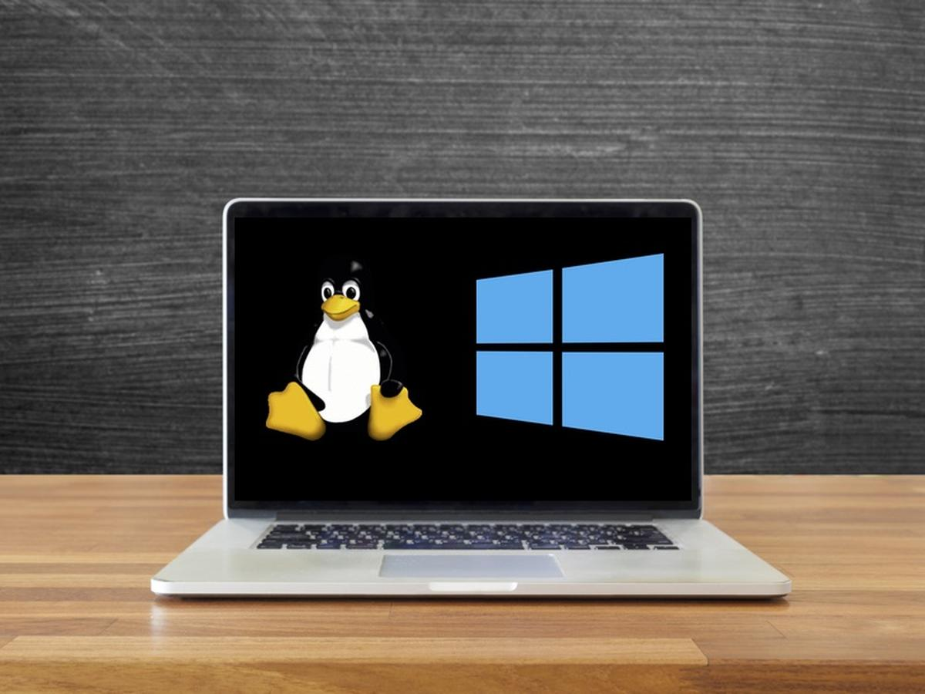
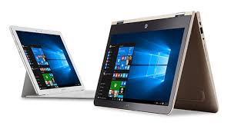
BIOS initialises
hardware
Host Security
BIOS calls MBR
(Master Boot Record)
Mac OSX
Linux
Load code from boot sector of active partition
Bootloader runs code and starts up operating system
Windows

Slide 3
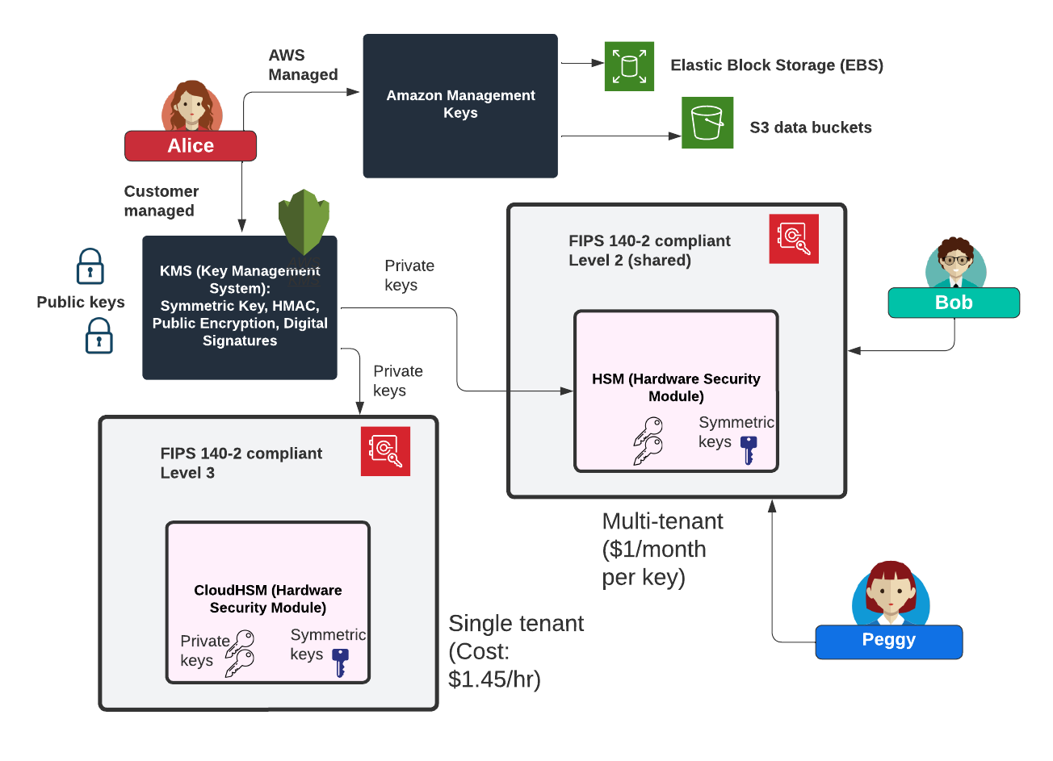
HSM or CloudHSM

Slide 4
Host Security
TPM Chip.
Apple T2 Chip.
Disk Encryption: BitLocker.
Disk Encryption: TrueCrypt.
Entropy.
Prof Bill Buchanan OBE http://asecuritysite.com/esecurity

Slide 5
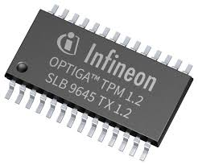
TPM 1.2 and 2.0
Crypto-processor
Random number generator.
RSA/ECC key generator.
HMAC generator.
SHA-1/SHA-256 hash generator.
Signature engine
Platform integrity. Makes sure the boot process is correct.
Disk encryption. The encryption key used for disk encryption is fully or partially defined by the SRK.
Password protection. The storage of the user’s password in the chip.
Versatile memory:
Platform Configuration Registers (PCR).
Attestation Identity Keys (AIK).
Storage Keys.
Persistent memory:
Endorsement Key (EK). A private key from a key pair. A user wishing to send a message to this TPM uses the public key to encrypt. Public key is also stored on TPM.
Storage Root Key (SRK). Used to encrypt disk storage.

Slide 6
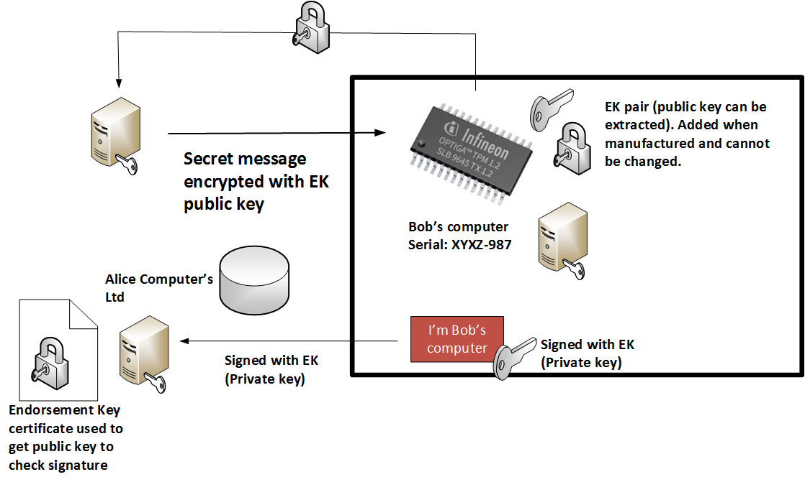
Endorsement Key (EK)

Slide 7
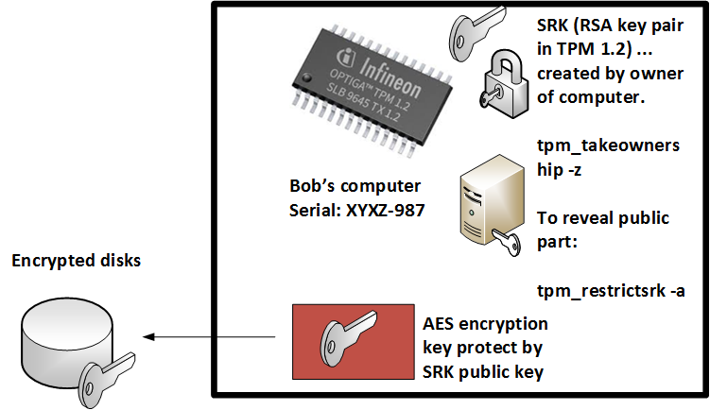
Storage Root Key (SRK)

Slide 8
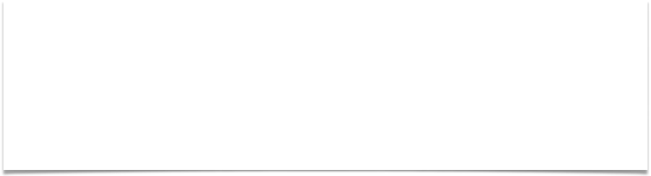
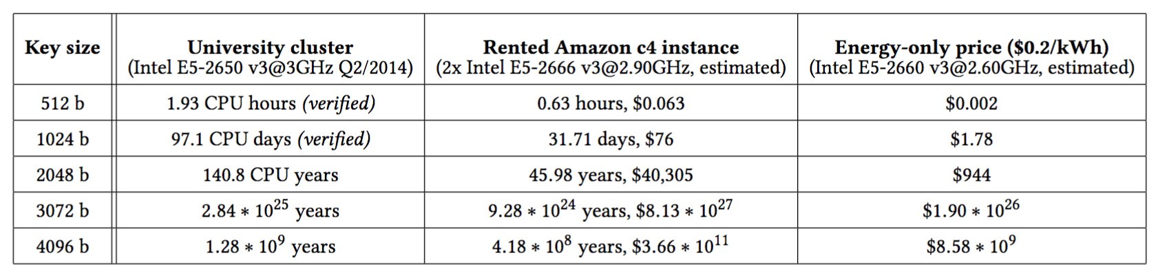
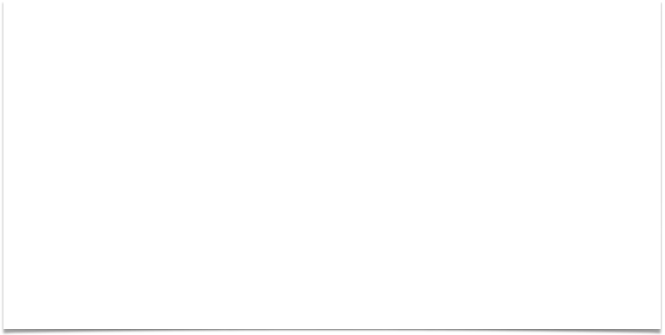
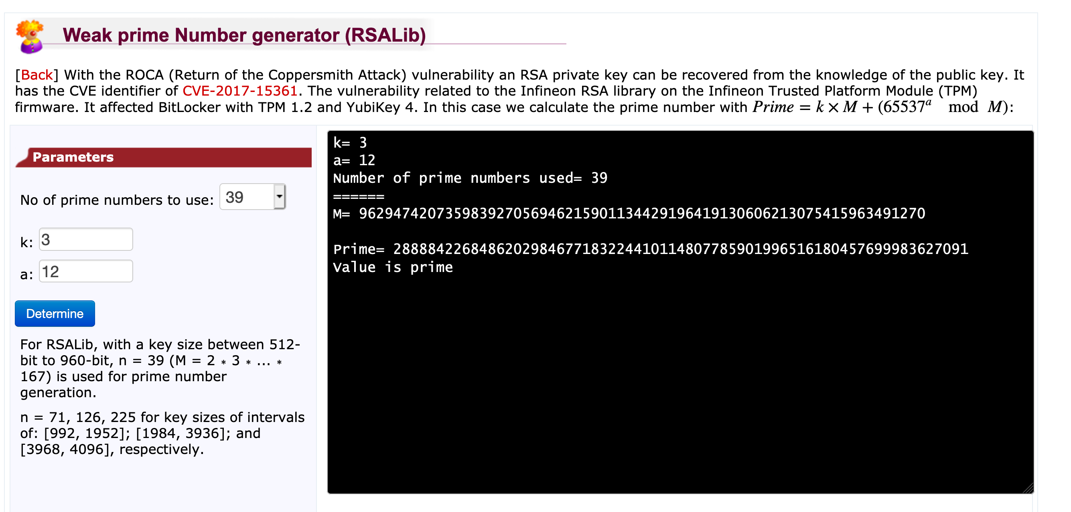
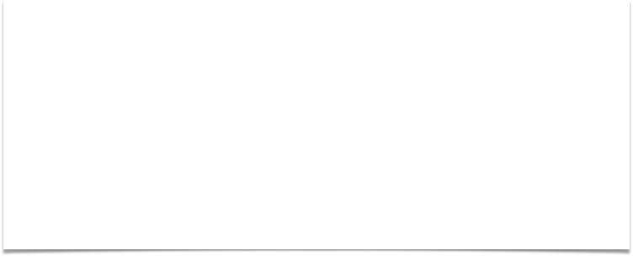
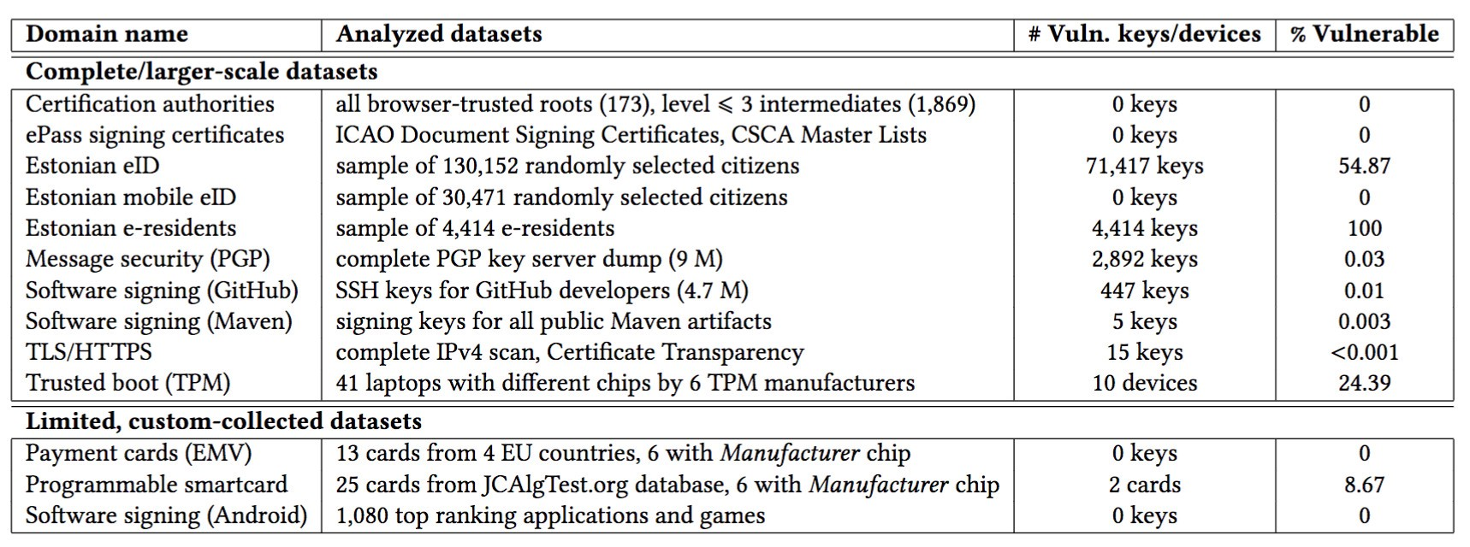
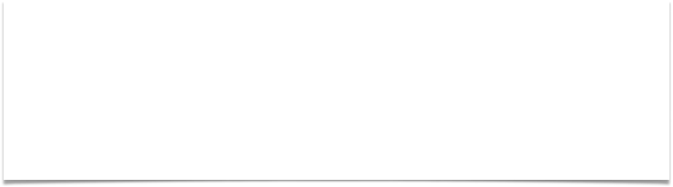
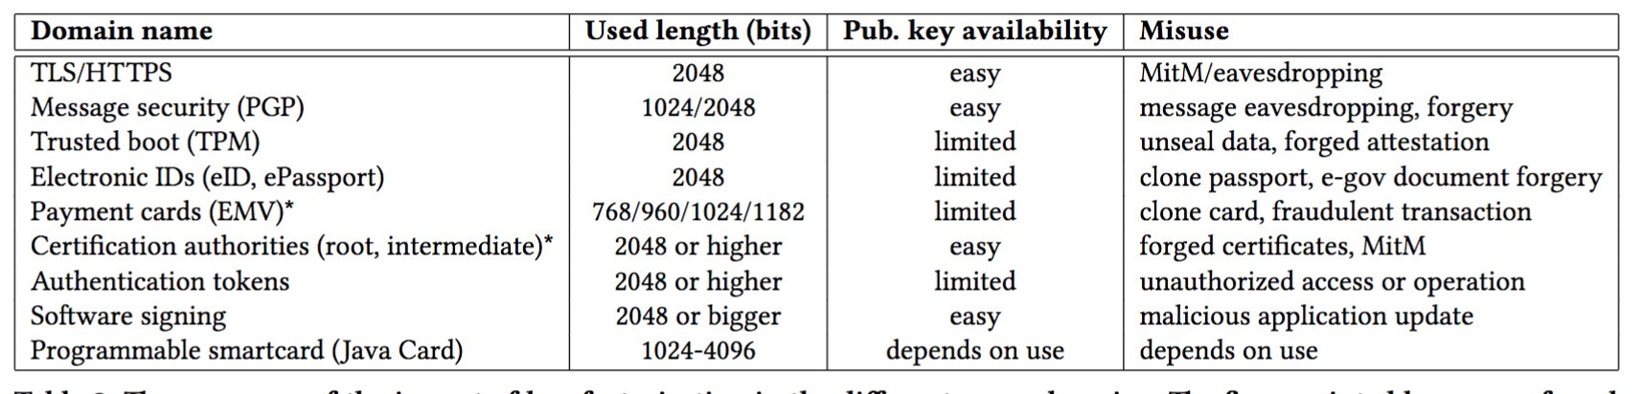
ROCA

Slide 9
Host Security
TPM Chip.
Apple T2 Chip.
Disk Encryption: BitLocker.
Disk Encryption: TrueCrypt.
Entropy.
Prof Bill Buchanan OBE http://asecuritysite.com/esecurity

Slide 10
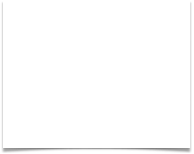
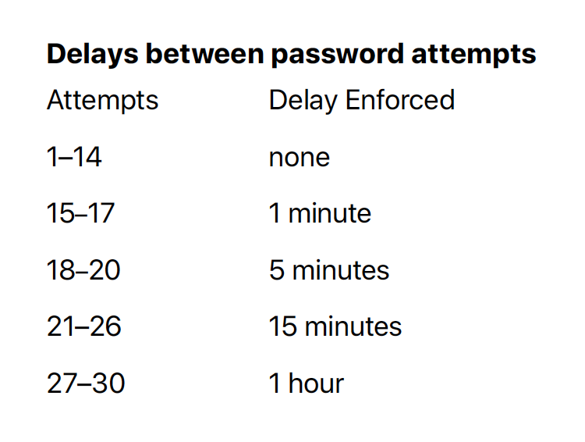

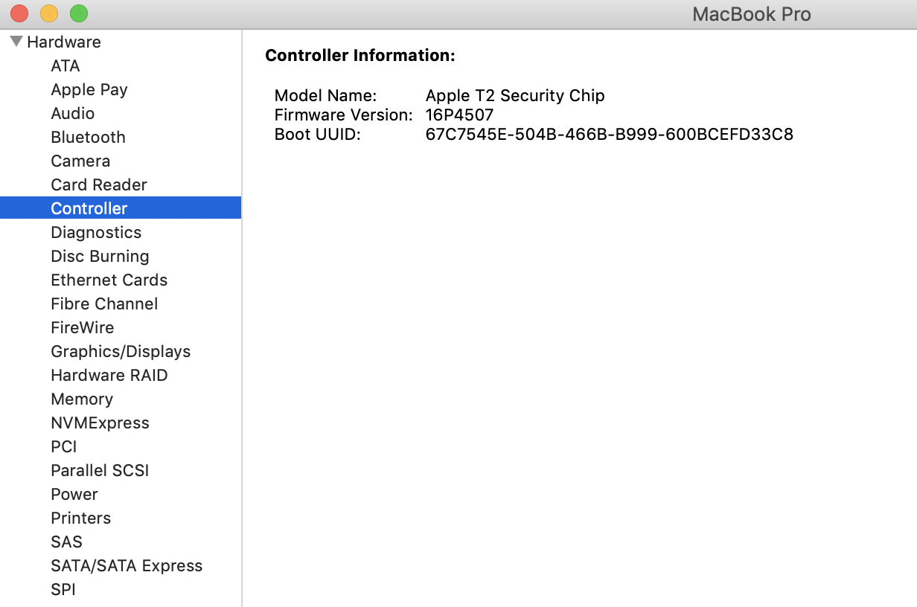
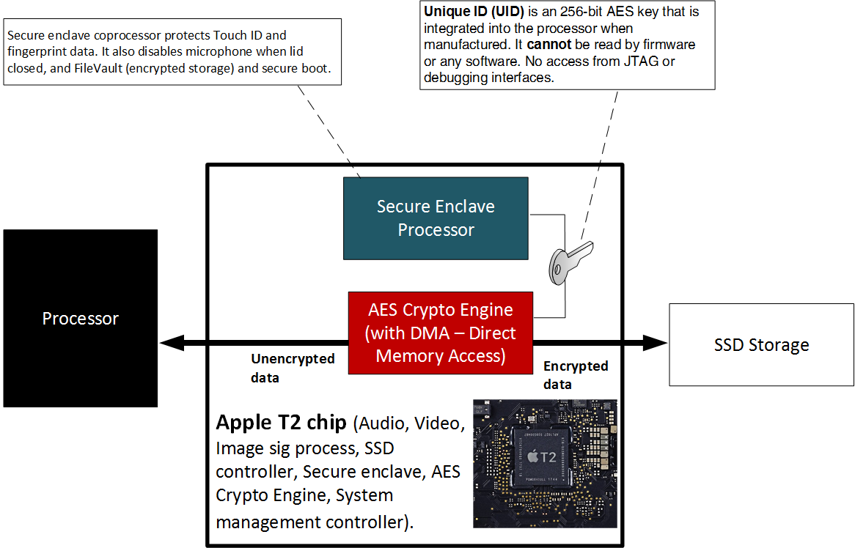
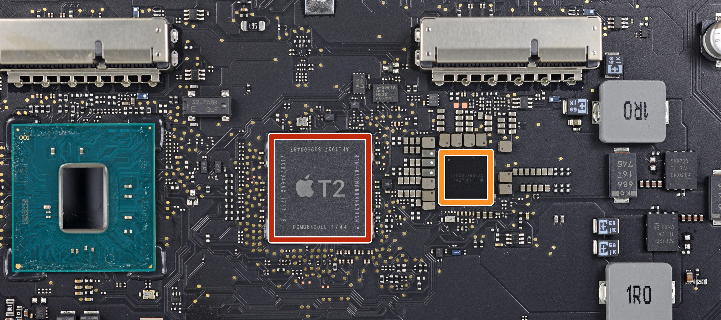
Apple T2 Chip
Apple T2 Chip.

Slide 11
Host Security
TPM Chip.
Apple T2 Chip.
Disk Encryption: BitLocker.
Disk Encryption: TrueCrypt.
Entropy. Prof Bill Buchanan OBE http://asecuritysite.com/esecurity

Slide 12
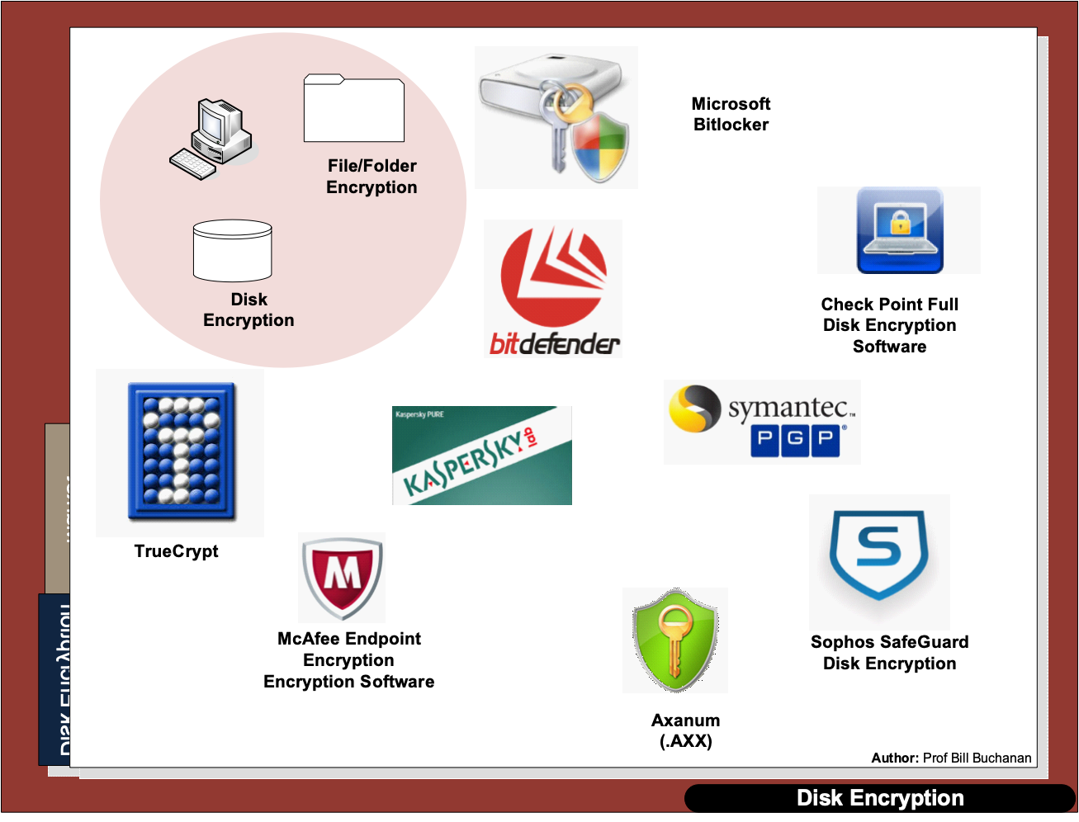

Slide 13
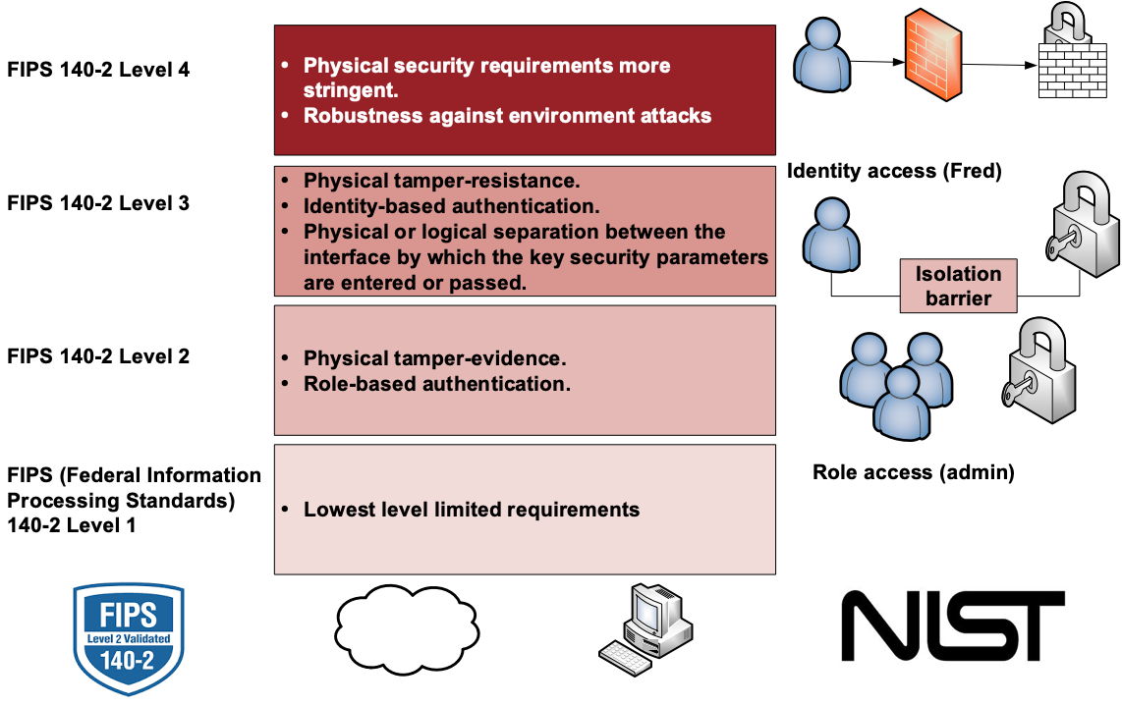
FIPS

Slide 14
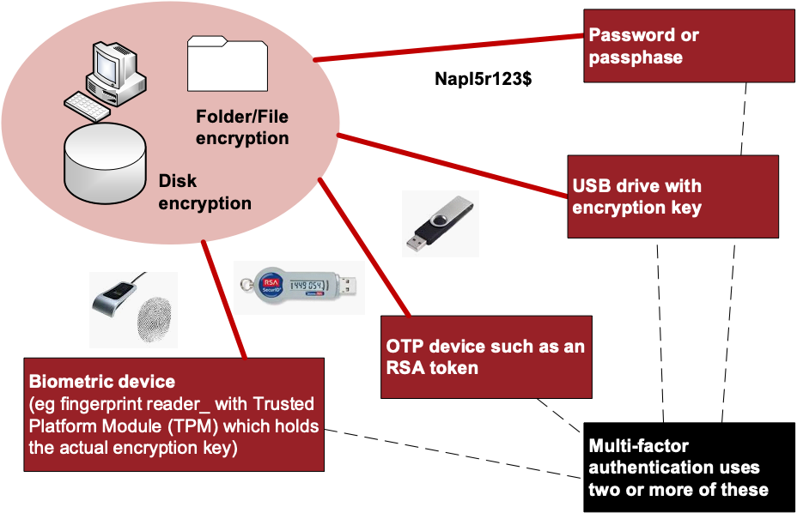

Slide 15
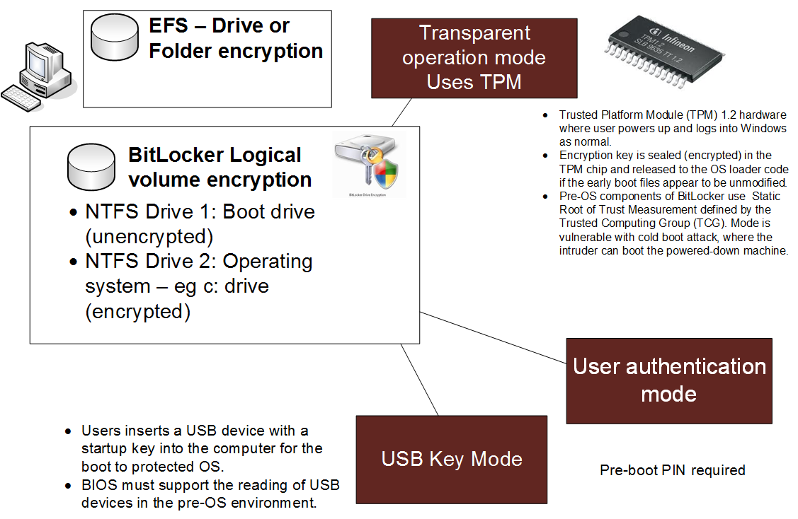

Slide 16
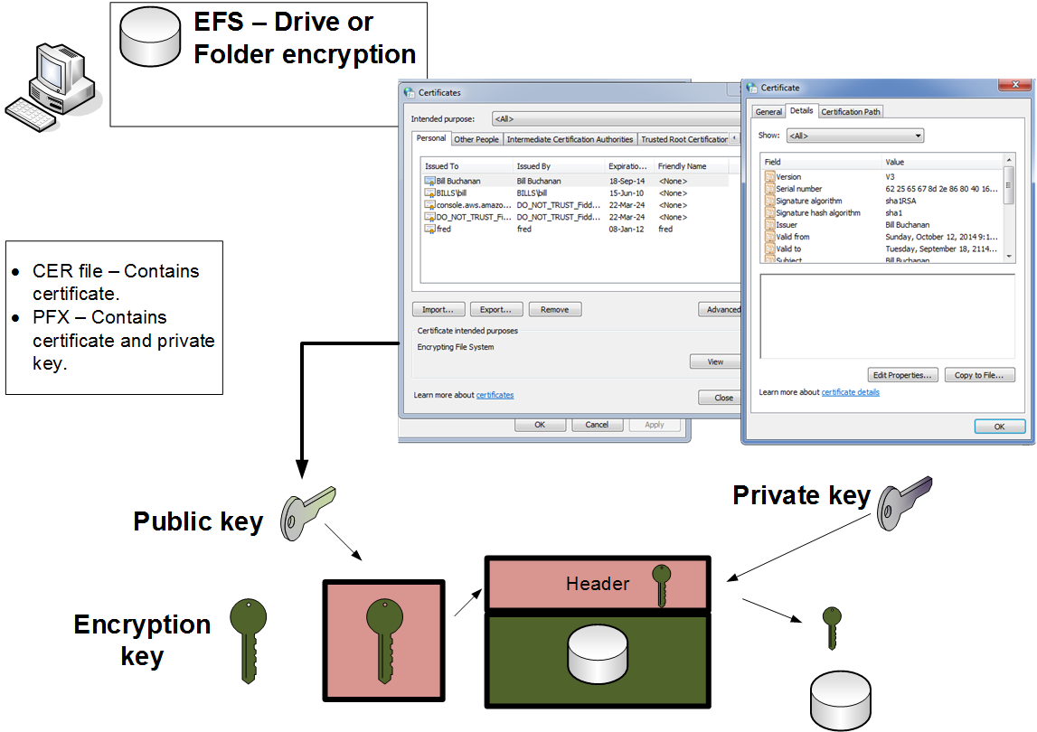
Microsoft EFS

Slide 17
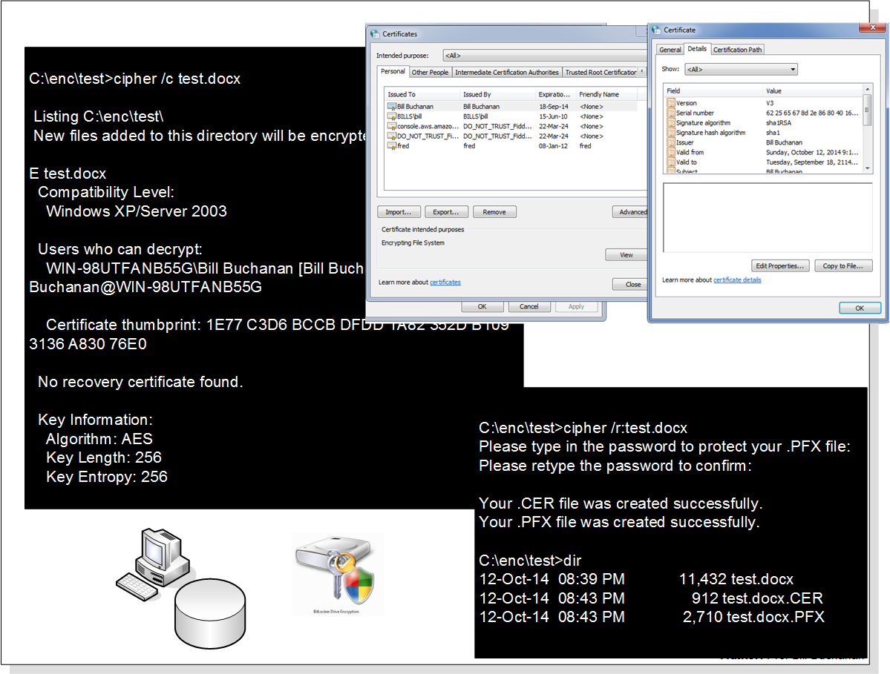

Slide 18
C:\enc\test>cipher /c test.docx
Listing C:\enc\test\
New files added to this directory will be encrypted.
E test.docx
Compatibility Level:
Windows XP/Server 2003
Users who can decrypt:
WIN-98UTFANB55G\Bill Buchanan [Bill Buchanan(Bill Buchanan@WIN-98UTFANB55G
Certificate thumbprint: 1E77 C3D6 BCCB DFDD 1A82 352D B109 3136 A830 76E0
No recovery certificate found.
Key Information:
Algorithm: AES
Key Length: 256
Key Entropy: 256

Slide 19
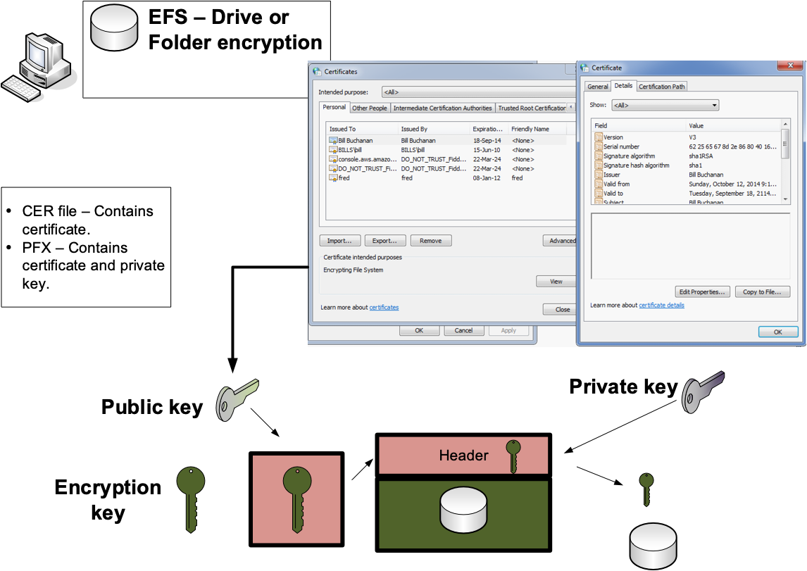
C:\enc\test>cipher /r:test.docx
Please type in the password to protect your .PFX file:
Please retype the password to confirm:
Your .CER file was created successfully.
Your .PFX file was created successfully.
C:\enc\test>dir
12-Oct-14 08:39 PM 11,432 test.docx
12-Oct-14 08:43 PM 912 test.docx.CER
12-Oct-14 08:43 PM 2,710 test.docx.PFX

Slide 20
Host Security
TPM Chip.
Apple T2 Chip.
Disk Encryption: BitLocker.
Disk Encryption: TrueCrypt.
Entropy. Prof Bill Buchanan OBE http://asecuritysite.com/esecurity

Slide 21
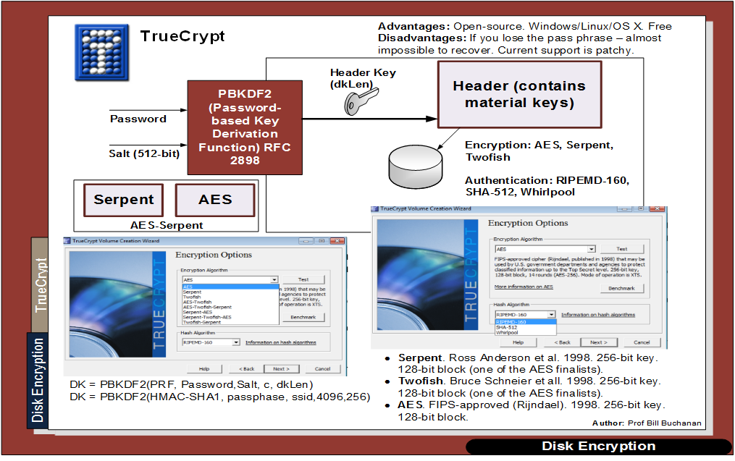

Slide 22
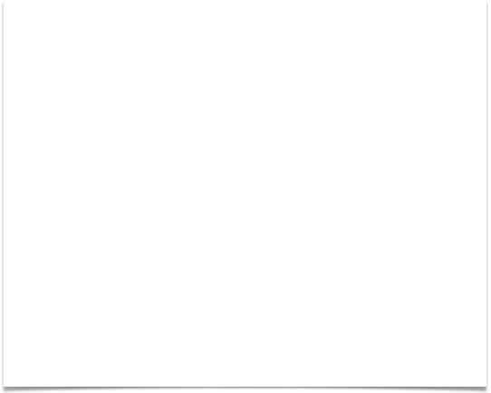
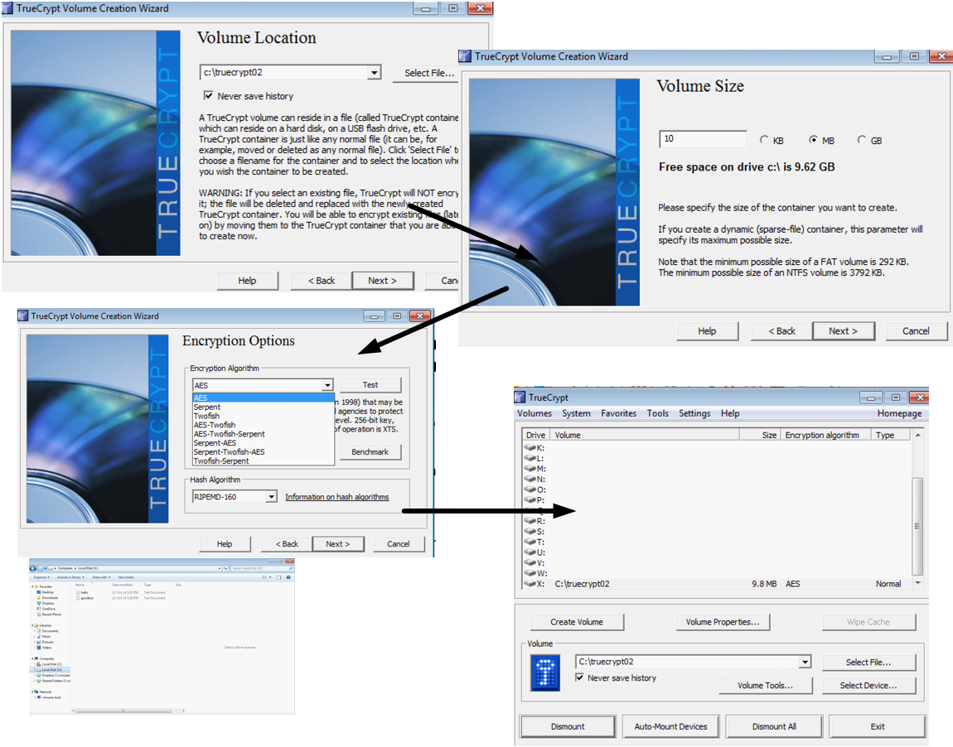
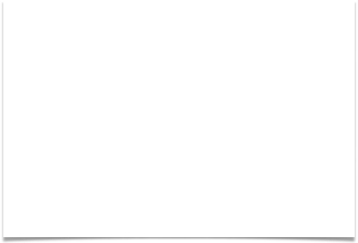
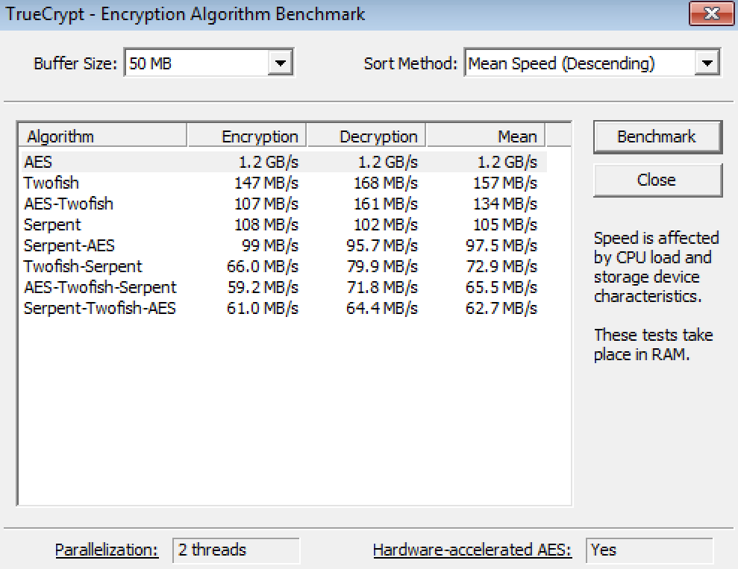
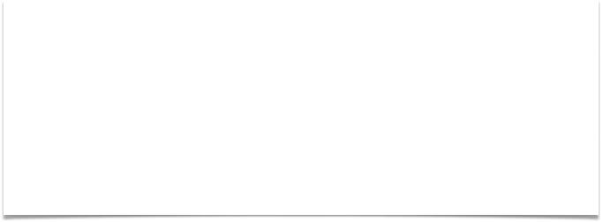
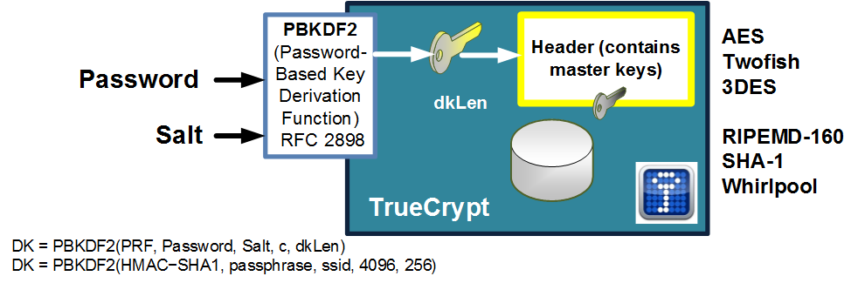

Slide 23
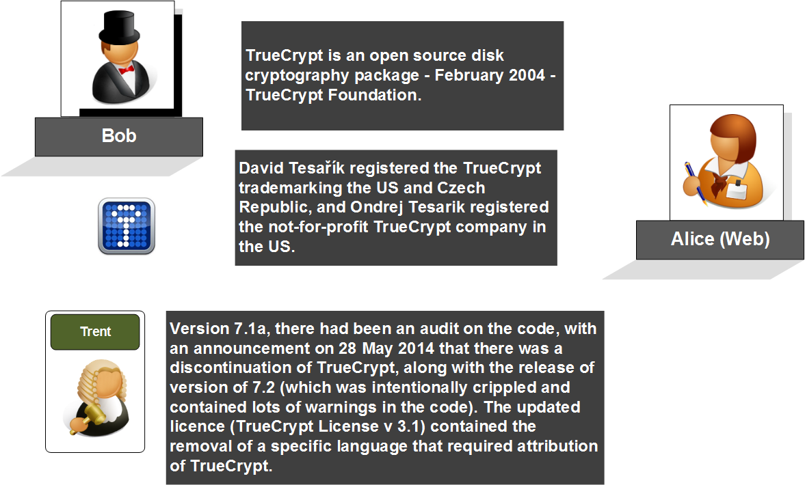

Slide 24
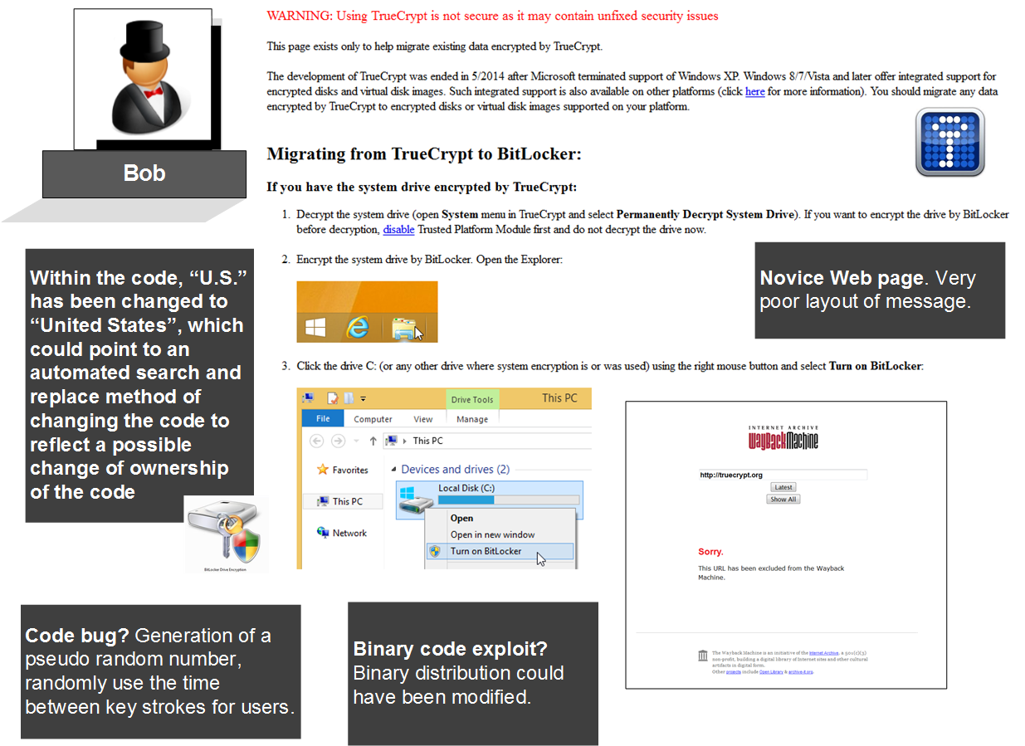

Slide 25
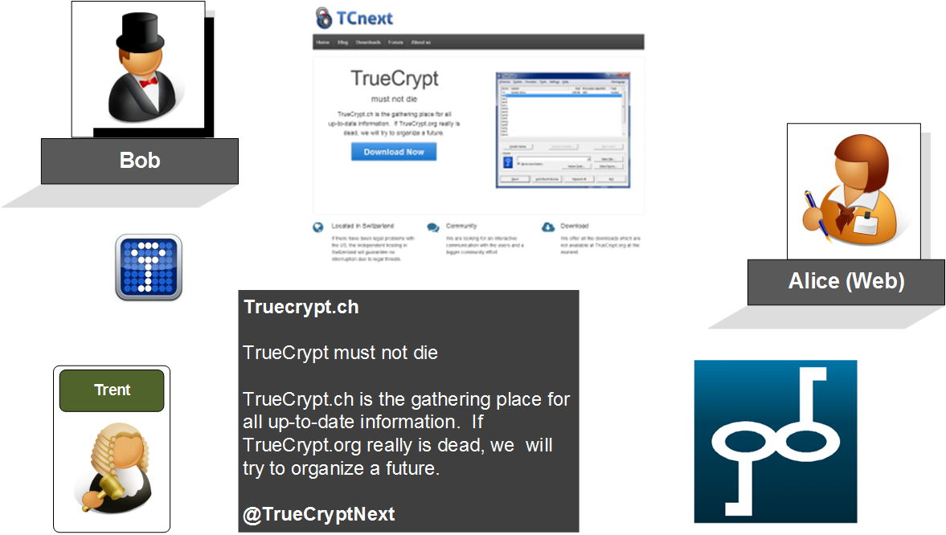

Slide 26
Host Security
TPM Chip.
Apple T2 Chip.
Disk Encryption: BitLocker.
Disk Encryption: TrueCrypt.
Entropy. Prof Bill Buchanan OBE http://asecuritysite.com/esecurity

Slide 27
An example of the first few bytes of TrueCrypt volume is:
4c 43 dd 86 cf 1f 69 eb 86 14 80 66 c9 2f 4b e2
f9 5a 01 c2 82 f4 bc c8 8b 71 59 3c 23 9b cc 40
ad 46 a7 b7 4e 00 45 98 d2 ea d2 32 26 a0 10 1c
67 80 2d 8a 08 61 ba c9 f6 d9 57 84 f2 93 11 18
C:\Python27>python en.py "c:\Campus&DL - WB.tc"
File size in bytes:
3145728
Shannon entropy (min bits per byte-character):
7.99994457357
Min possible file size assuming max theoretical compression efficiency:
25165649.6435 in bits
3145706.20544 in bytes
File size in bytes:
318724
Shannon entropy (min bits per byte-character):
7.98787618412
Min possible file size assuming max theoretical compression efficiency:
2545927.84891 in bits
318240.981113 in bytes
File size in bytes:
62464
Shannon entropy (min bits per byte-character):
4.64286159485
Min possible file size assuming max theoretical compression efficiency:
290011.706661 in bits
36251.4633326 in bytes

Slide 28
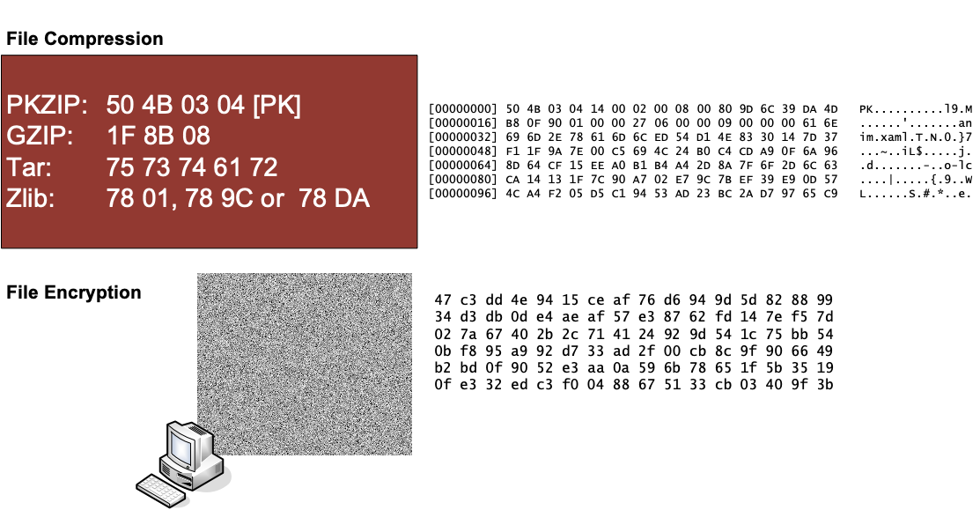

Slide 29
Host Security
TPM Chip.
Apple T2 Chip.
Disk Encryption: BitLocker.
Disk Encryption: TrueCrypt.
Entropy.
Prof Bill Buchanan OBE http://asecuritysite.com/esecurity

